Slide 1


Personal Expense Tracker
A Full-Stack Solution for Modern Financial Management
Name: Srivatsan T
Reg. No: 43120214
Batch: JFS ST - 02

Slide 2




Project Abstract: Managing Personal Finances Digitally
The Personal Expense Tracker is a full-stack web application designed to empower users in managing their personal finances efficiently and securely.
Full-Stack Web Application
Core Functionality
Visual Dashboard
Utilising modern development standards for robust performance and a smooth user experience across devices.
Includes secure Authentication, comprehensive Expense CRUD (Create, Read, Update, Delete), and visual data representation.
Provides users with immediate, insightful visual analytics of their spending patterns using Chart.js.

Slide 3


Limitations of the Existing System
Current manual methods of expense tracking are inefficient and lack the security and analytical capabilities required by modern users.
Manual Tracking
No Security or Sync
Limited Analytics
Reliance on physical notebooks or error-prone spreadsheets for data entry.
Data is vulnerable and lacks real-time synchronisation across different devices.
Absence of sophisticated data analysis tools and accessibility issues for reviewing data.

Slide 4
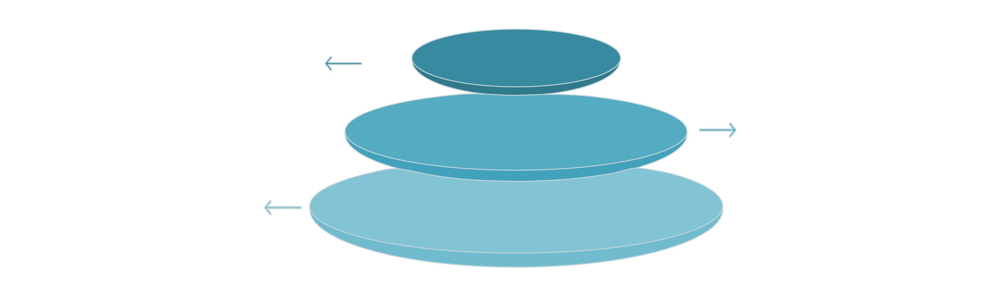
Proposed System Architecture: Web-Based and API-Driven
My solution is built on a robust, three-tier architecture ensuring scalability and maintainability.
Frontend
React SPA handling UI and user interactions
Backend
Spring Boot RESTful APIs for business logic
Database
MongoDB storing application data and documents
Frontend Layer (React)
Backend Layer (Spring Boot)
Data Layer (MongoDB)
Provides the dynamic user interface and ensures a smooth, interactive experience. Implements data visualisation via Chart.js.
The core logic engine, exposing secure RESTful APIs for all CRUD operations and handling user authentication.
NoSQL database for flexible and persistent storage of user profiles and expense records.

Slide 5




Key Advantages of the New System
Leveraging modern technologies delivers a superior, secure, and insightful financial tracking experience.
User-Friendly Design
Secure & Real-Time
Intuitive and responsive interface that adapts seamlessly across all devices.
Features robust authentication and instantaneous data updates for accurate tracking.
Visual Analytics
Scalable Platform
Transforming raw data into clear charts, providing deep insights into spending habits.
The architecture supports future expansion and is accessible across various operating systems and browsers.

Slide 6


Identified Disadvantages and Limitations
While robust, the current implementation presents certain limitations that need consideration for future planning.
Internet Dependency
The web application requires a stable internet connection for full functionality and data synchronisation.
Basic Password Security
Initial implementation uses standard hashing; advanced features like multi-factor authentication and stronger encryption are needed.
MongoDB Performance Limits
Potential performance degradation when handling extremely large volumes of historical data over time.
User Familiarity Requirement
Requires users to be comfortable interacting with web-based application interfaces for optimal use.

Slide 7
System Requirements: Software and Hardware
Ensuring the correct environment for development, deployment, and end-user access.
Software Stack
Hardware Specifications
Backend: Java 17, Spring Boot, Maven
Server: Recommended 4GB RAM, 2-core CPU, 20GB Storage for smooth operation.
Frontend Build: Node.js, React, Axios
Data Visualisation: Chart.js Library
Client: Any modern device running an up-to-date web browser (Chrome, Firefox, Safari, Edge).
Development Tools: VS Code, Git Version Control
Operating Systems: Compatible across Windows, macOS, and Linux environments.

Slide 8





Core System Modules Overview
The application is logically segmented into five interconnected modules, each handling distinct critical functions.
User Module
Manages user registration, profile updates, and login validation via secure REST APIs.
Expense Module
Handles all transactional logic: adding, modifying, deleting, and fetching expense records.
Dashboard Module
Renders visual analytics and summary reports of spending using Chart.js.
Auth Module
Ensures secure, session-based access control and protects private user data.
Data Module
Manages data persistence and retrieval, integrating the application with the MongoDB database.

Slide 9
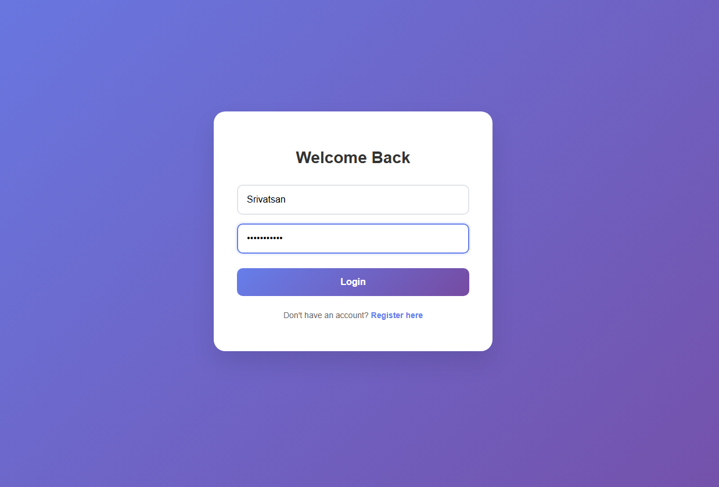
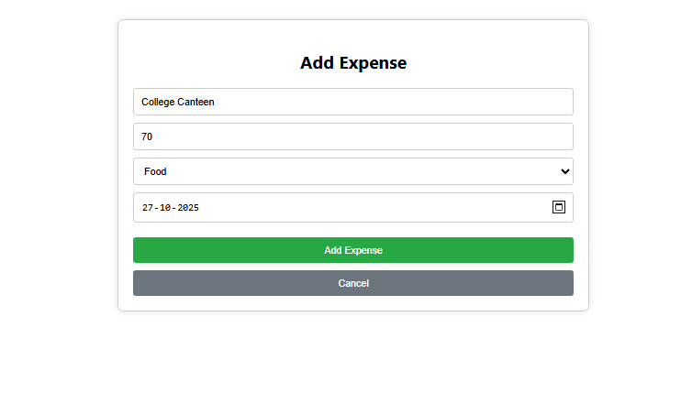
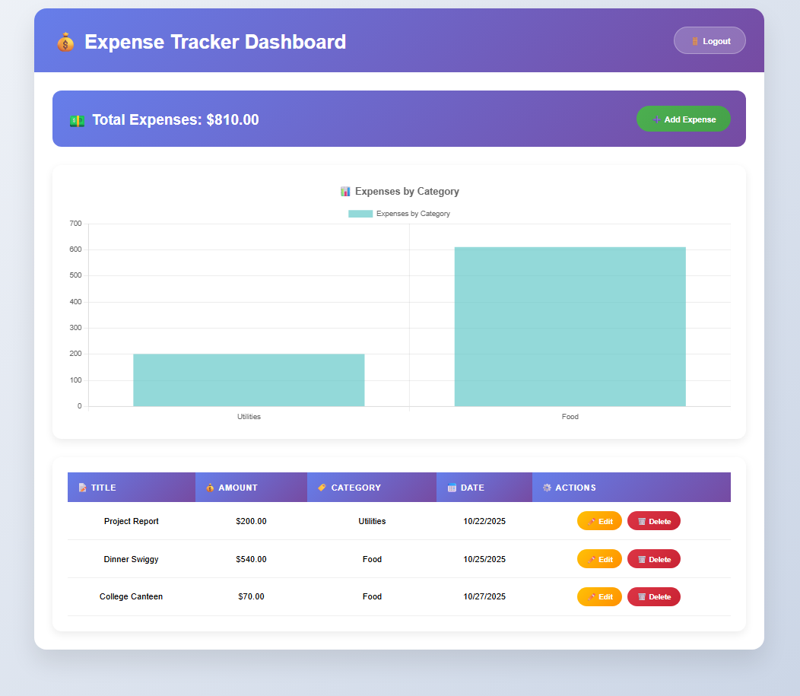
Dashboard: Visualising Financial Health
The dashboard is the central feature, translating complex financial data into easily digestible visual insights.
Expense Visualisation
Allows users to quickly see where their money is going, broken down by customisable categories.
API-Fetched Data
All chart data is retrieved dynamically and securely from the Spring Boot backend APIs.
Spending Insights
Provides clear visibility into spending trends, facilitating better budgeting and financial control.

Slide 10








Conclusion and Future Scope
The Personal Expense Tracker offers a significant upgrade from manual methods, providing an automated and secure solution.
Security Enhancement
Future Scope
Implement stronger data encryption protocols for maximum user data protection.
Integrate an offline mode for data entry in low-connectivity areas.
Bridging the Gap
Core Achievement
Moves users from manual, error-prone systems to a modern, digital environment.
Successfully automates and secures personal expense tracking tasks.

